Slide 1

Algorithm Analysis IT-2101 Lecture - 7
Dr. Mohammad Abu Yousuf
yousuf@juniv.edu

Slide 2
Dynamic Programming-1

Slide 3
Introduction
Dynamic programming, like the divide-and-conquer method, solves problems by combining the solutions to subproblems.
Divide-and-conquer algorithms partition the problem into disjoint subproblems, solve the subproblems recursively, and then combine their solutions to solve the original problem.
In contrast, dynamic programming applies when the subproblems overlap—that is, when subproblems share subproblems.
In this context, a divide-and-conquer algorithm does more work than necessary, repeatedly solving the common subproblems.
A dynamic-programming algorithm solves each subproblem just once and then saves its answer in a table, thereby avoiding the work of re-computing the answer every time it solves each subproblem.

Slide 4
Introduction
Main idea:
set up a recurrence relating a solution to a larger instance to solutions of some smaller instances
- solve smaller instances once
record solutions in a table
extract solution to the initial instance from that table
Bottom-up design:
Start at the bottom
Solve small sub-problems
Store solutions
Reuse previous results for solving larger sub-problems

Slide 5
Example: Fibonacci numbers
Recall definition of Fibonacci numbers:
F(n) = F(n-1) + F(n-2)
F(0) = 0
F(1) = 1
Computing the n^{th} Fibonacci number recursively (top-down):
F(n)
F(n-1) + F(n-2)
F(n-2) + F(n-3) F(n-3) + F(n-4)
...

Slide 6
Example: Fibonacci numbers (cont.)
Computing the n^{th} Fibonacci number using bottom-up iteration and recording results:
F(0) = 0
F(1) = 1
F(2) = 1+0 = 1
…
F(n-2) =
F(n-1) =
F(n) = F(n-1) + F(n-2)
Efficiency:
- time
- space
What if we solve it recursively?
n
n

Slide 7
Examples of DP algorithms
Matrix Chain Multiplication
Computing a binomial coefficient
Longest common subsequence
Warshall’s algorithm for transitive closure
Floyd’s algorithm for all-pairs shortest paths
Constructing an optimal binary search tree
Some instances of difficult discrete optimization problems:
- traveling salesman
- knapsack

Slide 8
Matrix Chain Multiplication
Given : a chain of matrices {A₁,A₂,…,A_{n}} to be multiplied.
Once all pairs of matrices are parenthesized, they can be multiplied by using the standard algorithm as a sub-routine.
A product of matrices is fully parenthesized if it is either a single matrix or the product of two fully parenthesized matrix products, surrounded by parentheses. [Note: since matrix multiplication is associative, all parenthesizations yield the same product.]

Slide 9
Matrix Chain Multiplication cont.
For example, if the chain of matrices is {A, B, C, D}, the product A, B, C, D can be fully parenthesized in 5 distinct ways:
(A ( B ( C D ))),
(A (( B C ) D )),
((A B ) ( C D )),
((A ( B C )) D),
((( A B ) C ) D ).
The way the chain is parenthesized can have a dramatic impact on the cost of evaluating the product.

Slide 10
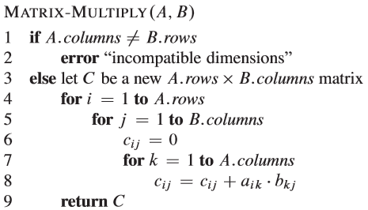
Matrix Chain Multiplication cont.
Consider ﬁrst the cost of multiplying two matrices.

Slide 11
Matrix Chain Multiplication cont.
We can multiply two matrices A and B only if they are compatible: the number of columns of A must equal the number of rows of B.
If A is a p x q matrix and B is a q x r matrix, the resulting matrix C is a p x r matrix. The time to compute C is dominated by the number of scalar multiplications in line 8, which is pqr.
In what follows, we shall express costs in terms of the number of scalar multiplications.

Slide 12
Matrix Chain Multiplication cont.
Example:
To illustrate the different costs incurred by different parenthesizations of a matrix product, consider the problem of a chain {A₁,A₂,A₃} of three matrix.
Three matrix = A[30][35], B[35][15], C[15][5].
Minimum of A*B*C
A*(B*C) = 30*35*5 + 35*15*5 = 7,585
(A*B)*C = 30*35*15 + 30*15*5 = 18,000

Slide 13
Matrix-chain multiplication problem
We state the matrix-chain multiplication problem as follows: Given a chain of n matrices {A₁,A₂,…,A_{n}} to be multiplied, where for i = 1,2,…..,n, matrix A_{i} has dimension p_{i-1} x p_{i}, fully parenthesize the product A₁A₂…..A_{n} in a way that minimizes the number of scalar multiplications.

Slide 14
Apply dynamic-programming
We shall use the dynamic-programming method to determine how to optimally parenthesize a matrix chain. In so doing, we shall follow the four-step sequence that we stated at the beginning of this chapter:
1. Characterize the structure of an optimal solution.
2. Recursively deﬁne the value of an optimal solution.
3. Compute the value of an optimal solution.
4. Construct an optimal solution from computed information.

Slide 15
Matrix Chain Multiplication Step 1: Structure of Optimal Parenthesization
For n matrices, let A_{i..j} be the result of A_{i}A_{i+1}….A_{j}
An optimal parenthesization of A_{i}A_{i+1}…A_{j} splits the product between A_{k} and A_{k+1} where i≤ k < j. Then, m[I,j] equals the minimum cost for computing the subproducts A_{i…k} and A_{k+1..j}, plus the cost of multiplying these two matrices together.
Example, if k = 4 then (A₁A₂A₃A₄)(A₅A₆)
Total cost of A_{1..6} = cost of A_{1..4} plus total
cost of multiplying these two matrices
together.

Slide 16

Matrix Chain Multiplication Step 2: A recursive solution
Next, we deﬁne the cost of an optimal solution recursively in terms of the optimal solutions to subproblems.
Let m[i,j] be the minimum number of scalar multiplications needed to compute the matrix A_{i..j.}
recursive deﬁnition for the minimum cost of parenthesizing the product A_{i}A_{i+1}…A_{j} becomes

Slide 17
Matrix Chain Multiplication Step 3: Computing the optimal costs
At this point, we could easily write a recursive algorithm based on previous slide recurrence equation to compute the minimum cost m[1,n] for multiplying A₁A₂…A_{n}

Slide 18
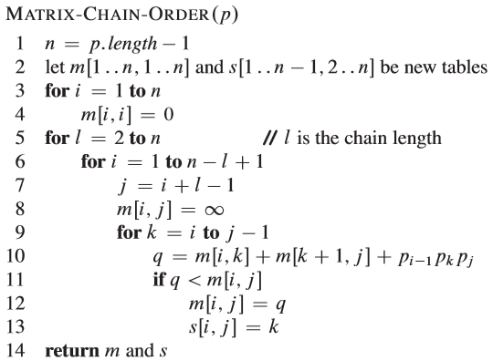
Matrix Chain Multiplication Step 3: Computing the optimal costs

Slide 19
Matrix Chain Multiplication Step 3: Computing the optimal costs
The algorithm uses an auxiliary table m[1..n,1..n] for storing the m[i,j] costs and another auxiliary table s[1..n-1,2..n]that records which index of k achieved the optimal cost in computing m[I,j]. We shall use the table s to construct an optimal solution.

Slide 20
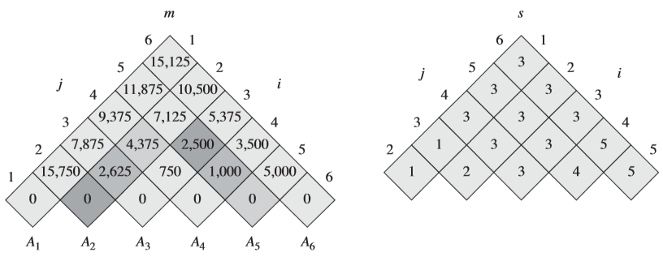
Matrix Chain Multiplication Step 3: Computing the optimal costs

Slide 21
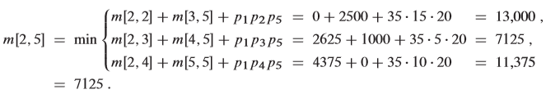
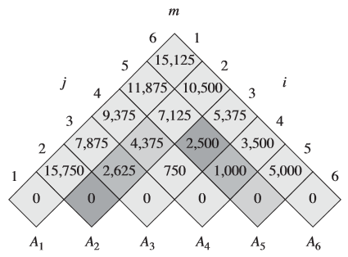

Slide 22
Running time
The minimum number of scalar multiplications to multiply the 6 matrices is m[1,6]= 15,125.
A simple inspection of the nested loop structure of MATRIX-CHAIN-ORDER yields a running time of O(n³) for the algorithm. The loops are nested three deep, and each loop index (l, i,andk)takes on at most n-1values.

Slide 23
Matrix Chain Multiplication Step 4: Constructing an optimal solution
Although MATRIX-CHAIN-ORDER determines the optimal number of scalar multiplications needed to compute a matrix-chain product, it does not directly show how to multiply the matrices.
The table s[1..n-1,2..n]gives us the information we need to do so. Each entry s[i,j] records a value of k such that an optimal parenthesization of A_{i}A_{i-1}…A_{j} splits the product between A_{k} and A_{k-1}.

Slide 24
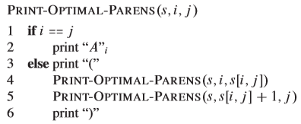
Matrix Chain Multiplication Step 4: Constructing an optimal solution
The following recursive procedure prints an optimal parenthesization of A_{i}A_{i+1}…A_{j} , given the s table computed by MATRIX-CHAIN-O RDER and the indices i and j.
In the example, the call PRINT-OPTIMAL-PARENS(s,1,6) prints the parenthesization ((A₁(A₂A₃))((A₄A₅)A₆)).

Slide 25
Thank you

